Slide 1

PCWG 2017 Roadmap
Friday, 09 June 2017
Copenhagen, Denmark
Peter Stuart

Slide 2
We’ve Always Known that Real World Wind Turbine Performance is NOT as Simple as Power=P(v, ρ)!
Extract from C.J. Christensen et al: ”Accuracy of power curve measurements”, Risø-M-2632, 1986...
”… The power curve is then seen as the relation between the power P(v) produced by this undisturbed wind v.
This definition is, however, of very doubtful value for a windmill in the natural wind. The main difficulty is that it assumes a smooth laminar flow of high degree of homogeneity and symmetry”
ρ = Air Density
P=P(v, ρ)
Power (P)
Wind Speed (v)
The PCWG aims to build industry consensus on how best to predict real world turbine performance and look beyond P=P(v, ρ). www.pcwg.org.

Slide 3
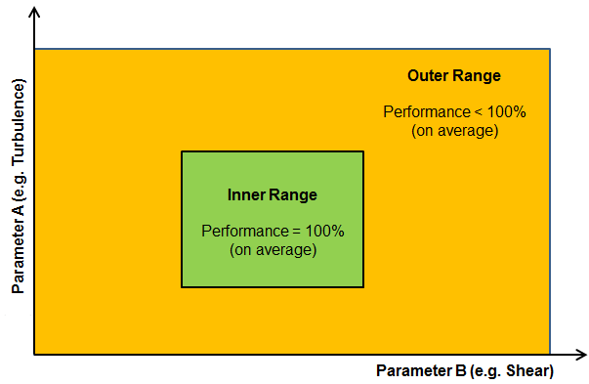
Reflecting the Real World: Inner-Outer Range Decomposition
Categories of Turbine Performance Corrections
PCWG Activities
Inner Range Performance
Adjustments to reflect the fact that even under warranted/ideal conditions performance may not be 100%
Outer Range
Outer Range Performance
Adjustments to reflect the fact that turbine performance may deviate from Inner Range behaviour in Outer Range Conditions
e.g. Low/High TI, Low/High Shear etc.
Inner Range
+ Other Performance Corrections
Icing, Blade Degradation, Sub-optimal performance etc.
Note: The PCWG Inner-Outer Range Proposal is Conceptual Decomposition, and does infer specific parameter ranges.

Slide 4
Reflecting the Real World: Average-Specific Decomposition
Categories of Turbine Performance Corrections
PCWG Activities
Average Performance
(Bulk) Adjustments to reflect the fact that on average (in all conditions) turbines may not meet their documented performance level
Remove Bias
Conditions Specific Performance
Adjustments to reflect the fact that turbine performance may deviate from average performance in ‘non-average’ Conditions
e.g. Low/High TI, Low/High Shear etc.
Remove Uncertainty
Improve Project Design
+ Other Performance Corrections
Icing, Blade Degradation, Sub-optimal performance etc.

Slide 5
Classification of PCWG Activities by Component
Note: whilst the two decompositions are subtly different, they are broadly compatible with respect to the roadmap e.g. actions to further ‘Inner Range’ understanding, will generally further ‘Average Performance’ understanding.
The type of PCWG activates differs strongly depending on the problem component
The PCWG is seeking to define an assessment framework to define how to make best use of historic power performance tests when predicting future inner/average performance.
Inner Range Performance
Average Performance
The PCWG is attempting to evaluate quantitative methods for predicting Outer/ Specific performance via the PCWG Intelligence Sharing Initiative (PCWG-Share-X)
Outer Range Performance
Conditions Specific Performance

Slide 6

Reflecting the Real World: Inner Range / Average Performance
Extract from ‘High Resolution Turbine-Specific Matrix’, Carl Ostridge DNV GL,
Colorado PCWG Meeting, 10 August 2016, download from www.pcwg.org.

Slide 7
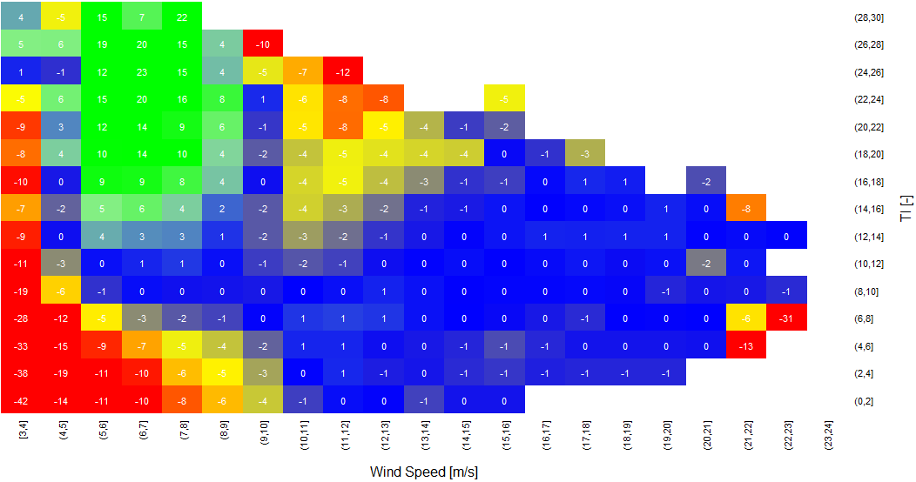
Reflecting the Real World: Outer Range Performance
Inner Range Performance
Outer Range Deviations (Observed – Base)
Colour = % Observed Power Deviation
(Observed - Base)
High TI & High V
Negative Deviation
High TI & Low V
Positive Deviation
Power (P)
P=P(v, ρ)
Turbulence Intensity [%]
Low TI & Low V
Negative Deviation
Wind Speed (v)
Wind Speed [m/s]

Slide 8
PCWG 2017 Roadmap

Slide 9
PCWG 2017 Roadmap
Roadmap Page 1/4
OUTCOME
1. Inner/Average Performance
Define best practice guidelines for stakeholder data exchange and analysis to establish inner/average performance
Evidence Pathway for Inner/Average Performance
→ Reduced Investor Risk
2. Outer/Specific Performance
Objectively determine/refine the best methods for modelling outer/specific performance using the PCWG-Share-X Platform
50% reduction in outer/specific modelling uncertainty
→ Reduced Investor Risk
3. Enabling Activities
Publically available worked Examples
PCWG Analysis Tool Development
The right tools & industry understanding to deliver items 1 & 2
NOW
End of 2017

Slide 10
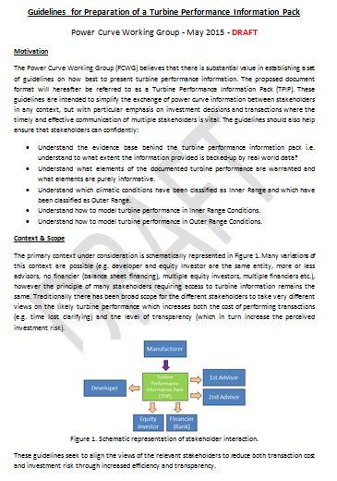
PCWG 2017 Roadmap
Roadmap Page 4/4
1. Inner/Average Performance
Define best practice guidelines for stakeholder data exchange and analysis to establish inner/average performance
2017 - Timeline
Draft Guidelines Document (based on a overhaul of existing DRAFT ‘guidelines for preparation of a turbine information pack’ document).
Aug
Sep
Feedback
Oct
Updated Draft Document
Nov
Final Feedback
Dec
Publication on PCWG Website

Slide 11
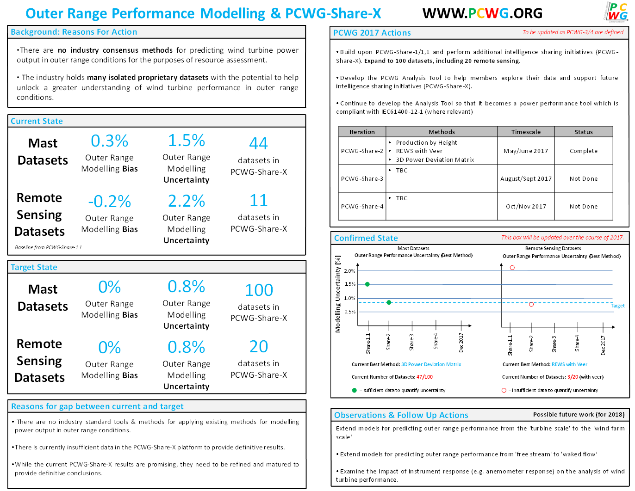
Roadmap Page 3/4
2. Outer/Specific Performance
2017 - Timeline
PCWG-Share-2
June
Aug
PCWG-Share-3
Oct
PCWG-Share-4

Slide 12
PCWG 2017 Roadmap
Roadmap Page 4/4
3. Enabling Activities
Publically Available Worked Examples
IEC Worked Examples
Non-IEC Worked Examples e.g. Production by Height, Marmander Interpolation etc.
PCWG Analysis Tool Development
Implementation of New Methods
Improved Testing and worked examples
Improved Beta Testing (Beta Testing Sub Group)
Improved Documentation (Beta Testing Sub Group)
Machine Learning
Sub-group meetings and discussions
Creation of Machine Learning Web Service for PCWG-Share-4
Publish Summary of PCWG Activities & Outcomes (on PCWG Website)

Slide 13
Questions/Discussion

